Slide 1

CSS Advanced
Course Overview
SoftUni Team
Technical Trainers
Software University
https://softuni.bg

Slide 2
Table of Contents
Introduction
Training and Team
Course Objectives
Course Organization

Slide 3
Have a Question?
sli.do
#front-end

Slide 4














SoftUni Diamond Partners

Slide 5
CSS Advanced
Course Topics

Slide 6

CSS Advanced – Course Topics
CSS Architecture - IT CSS
CSS Architecture - BEM
CSS Transitions, Animations and Transformations
SASS
CSS Grid

Slide 7

Trainers and Team

Slide 8
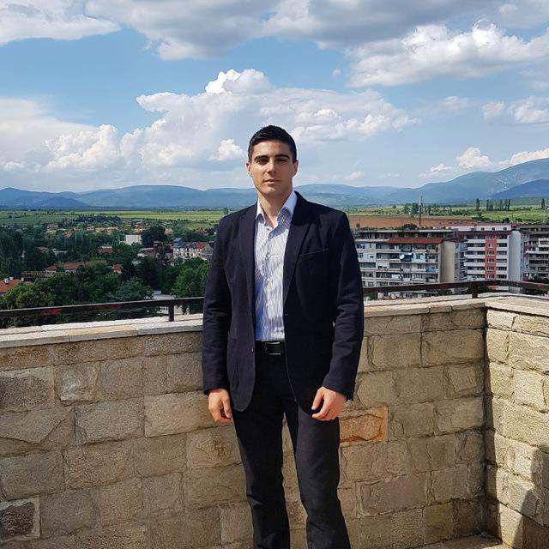
William Abboud
Full Stack & Senior Front-End Developer @ SoftUni
Studied Computer Science in Newcastle University
Passionate about
HTML/CSS/JS/React.js
UX/UI Design

Slide 9

Course Objectives
Course Details and Schedule

Slide 10

Training Duration
Defense date: 09 August 2020
Retake defense date: 15 August 2020
Project Defense: 15 minutes

Slide 11
Exam
Project Defense
Requirements for Project Assignment:
You can defend your project online
Examples
https://softuni.bg/trainings/resources/
https://donchomitev.github.io/CoffeeShop/
https://ddanailova.github.io/baby-album/

Slide 12

Course Organization
Resources

Slide 13


Scoring System for the Course
Theoretical Exam 5%
Project Defense 90%
Evaluation
Homework 5 %

Slide 14
Homework Assignments
Each lesson is followed by a few exercises
Homework assignments are due in 7 days after each lesson
Submission through the course page

Slide 15
Learn to Search in Internet & Find Solutions
The course assignments require to search in Internet
This is an important part of the learning process
Some exercises intentionally have no hints
Learn to find solutions!
Software development includes everyday searching and learning
No excuses, just learn to study!
Developers learn new technologies, tools, languages every day!

Slide 16
Website, Forum and FB Group
Official website:
Official discussion forum:
Official Facebook group:
https://softuni.bg/trainings/2451/css-advanced-november-2019
https://softuni.bg/forum/categories/68/web-basics
https://www.facebook.com/groups/FrontEndSeptember2019/

Slide 17
Code Editors
You may try many HTML authoring tools
Recommended:
Visual Studio Code
Other notable editors:
WebStorm
Sublime Text / Atom / Brackets

Slide 18
Questions?
Notes:
18

Slide 19
Trainings @ Software University (SoftUni)
Software University – High-Quality Education, Profession and Job for Software Developers
softuni.bg
Software University Foundation
softuni.foundation
Software University @ Facebook
facebook.com/SoftwareUniversity
Software University Forums
forum.softuni.bg
Notes:
19

Slide 20

License
This course (slides, examples, demos, exercises, homework, documents, videos and other assets) is copyrighted content
Unauthorized copy, reproduction or use is illegal
© SoftUni – https://softuni.org
© Software University – https://softuni.bg
Notes:
20

